Slide 1
Artist Presentation
Reuben Margolin
Clarissa Wu | DesInv 23 Summer 2020

Slide 2
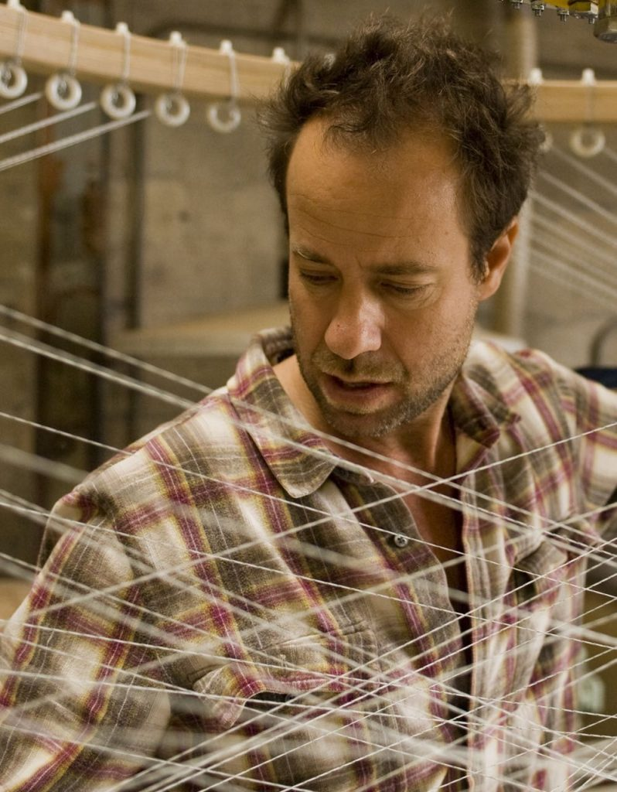
Reuben Margolin
Artist from Berkeley and works in his studio in Emeryville
Graduated from Harvard with an English degree
Has been making kinetic sculptures for 20 years, combining nature and math, inspired by waves and the wind

Slide 3
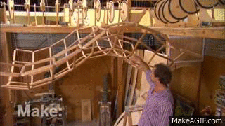
The Wave in Motion - 2005
Inspired by wheat fields which created wave forms in the wind in Spain
The wave is made of
144 fifteen inch long lengths of tapered fir dowels, hangs from steel cables
Motion: Asina+Bsinb+C
C = height of the wave
A and B = amplitudes, and
a and b = speed of rotation and position of each cam

Slide 4
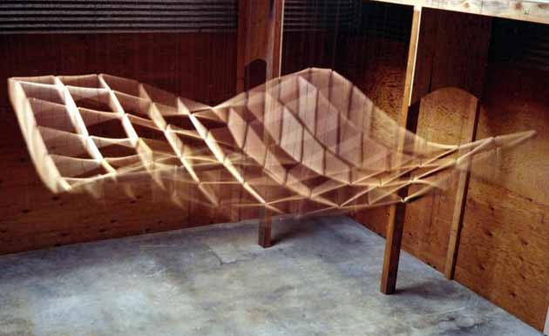
motors rotating the camshafts can vary in speed giving the generated wave a period between 100 and 10 seconds in either direction
[Description by Margolin]

Slide 5
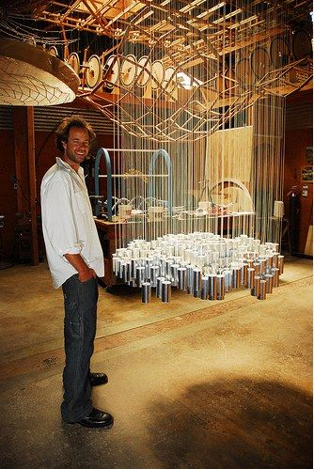
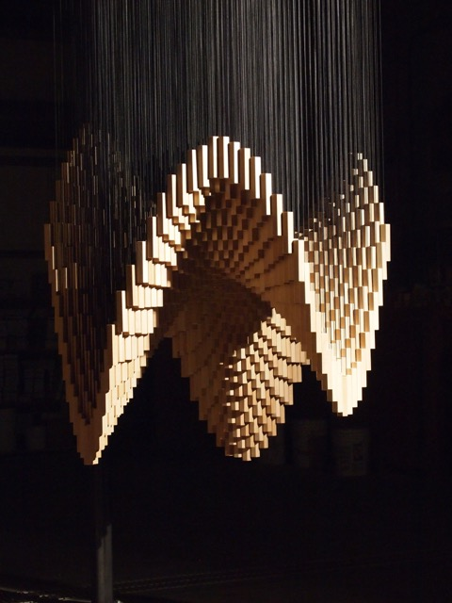
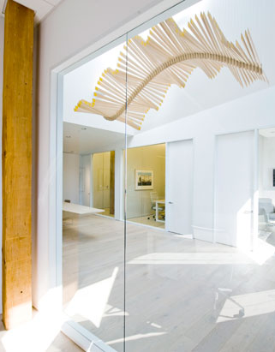
More of Reuben Margolin’s works

Slide 6
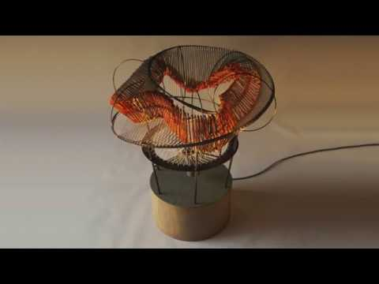
Mobius Wave | 2019
Steel
Wood
String
One electric motor

Slide 7

Helio Curve | Milan Design Week 2015

Slide 8
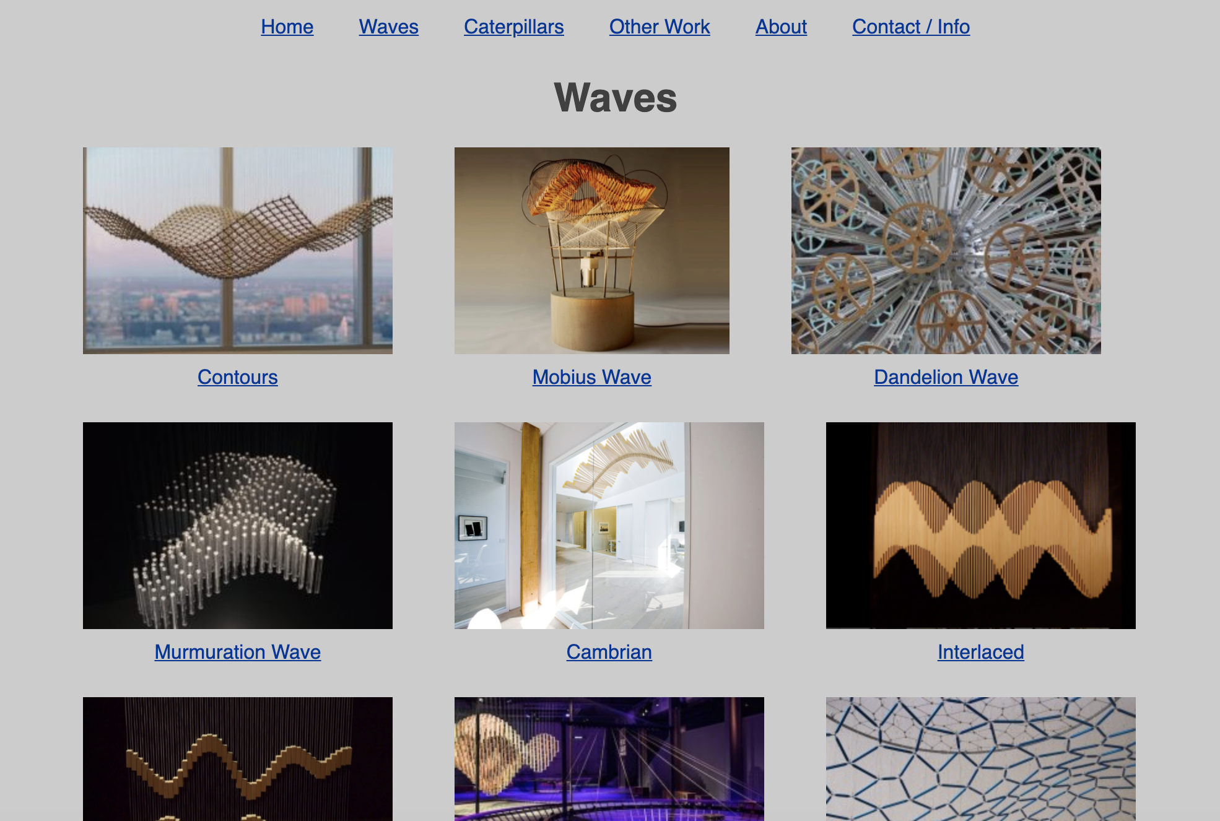
Link

Slide 9
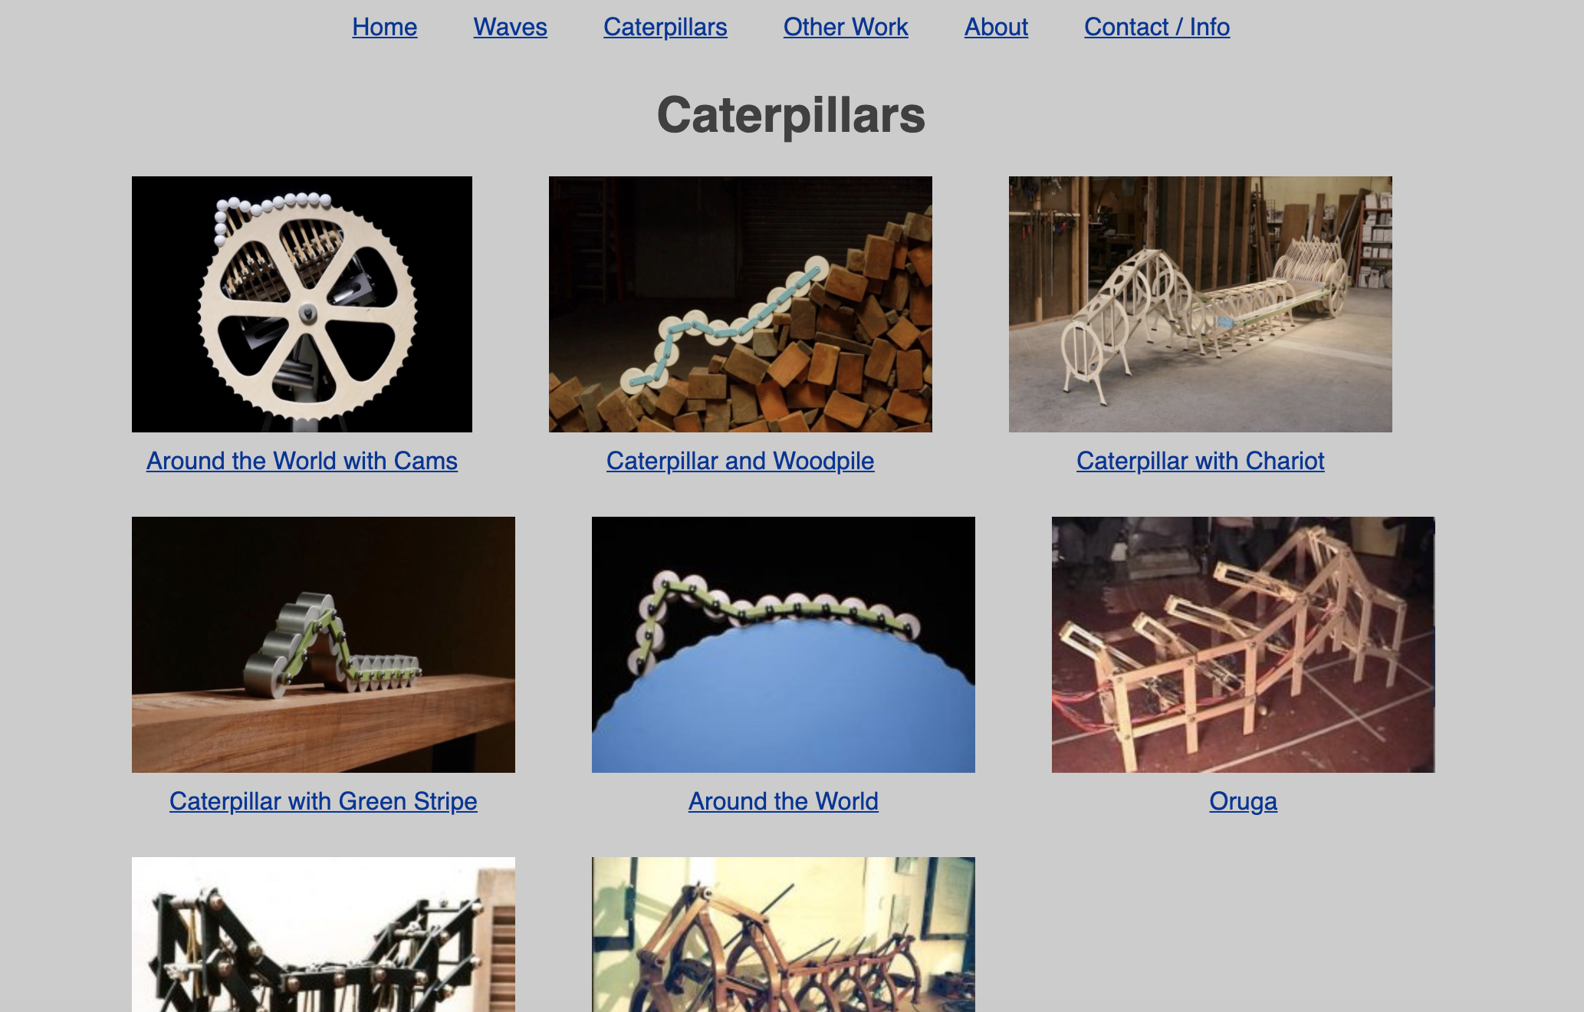
Link

